Slide 1

Data Insights Azure Databricks Terraform

Slide 2
Introduction
Databricks artefacts are currently deployed through a combination of Azure DevOps release pipeline, semi-automated and manual activity
The following are the high-level artefacts that are created in databricks, with permissions for each:
  Workspace folders
  Unity Catalog – Credentials, external locations, catalogs, schemas, volumes, tables, etc.
  Workflow jobs & pipelines
  Compute policies and clusters
  Notebooks/Files
  Dashboards
There is work in progress to deploy certain components to Databricks using asset bundles, such as:
  Workflow jobs & pipelines
  Notebooks
  Dashboards

Slide 3
Scope
The below tables identifies what is in scope for inclusion in terraform. All items in scope will include permissions where applicable
Scope Item | Current Data Insights | Data Insights | Current Data Science | Data Science
Groups and Users |  | Not in scope – post transition away from SCIM connector
Workspace Entitlements | API – Partial | In Scope | Manual | In Scope
Cluster Policies | API – Partial | In Scope | Manual | In Scope
Interactive Clusters | API - Partial | In Scope | Manual | In Scope
SQL Warehouse Clusters | API – Partial | In Scope | Manual | In Scope
Workspace Folders | API - Partial | In Scope | Manual | In Scope
Unity Catalog : Credentials | Excel and SQL | In Scope | Excel and SQL | In Scope
Unity Catalog : External Locations | Excel and SQL | In Scope | Excel and SQL | In Scope
Unity Catalog : Catalog | Excel and SQL | In Scope | Excel and SQL | In Scope
Unity Catalog : Schema | Excel and SQL | In Scope | Excel and SQL – Partial | For specific catalogs, otherwise managed in asset bundle
Unity Catalog : Volumes | Excel and SQL | In Scope | Excel and SQL – Partial | In Scope
Unity Catalog : Workspace Binding | API - Partial | In Scope | Manual | In Scope
Unity Catalog : Connections | Manual | In Scope | Manual | In Scope
Unity Catalog : Foreign Catalog | Manual | In Scope | Manual | In Scope

Slide 4
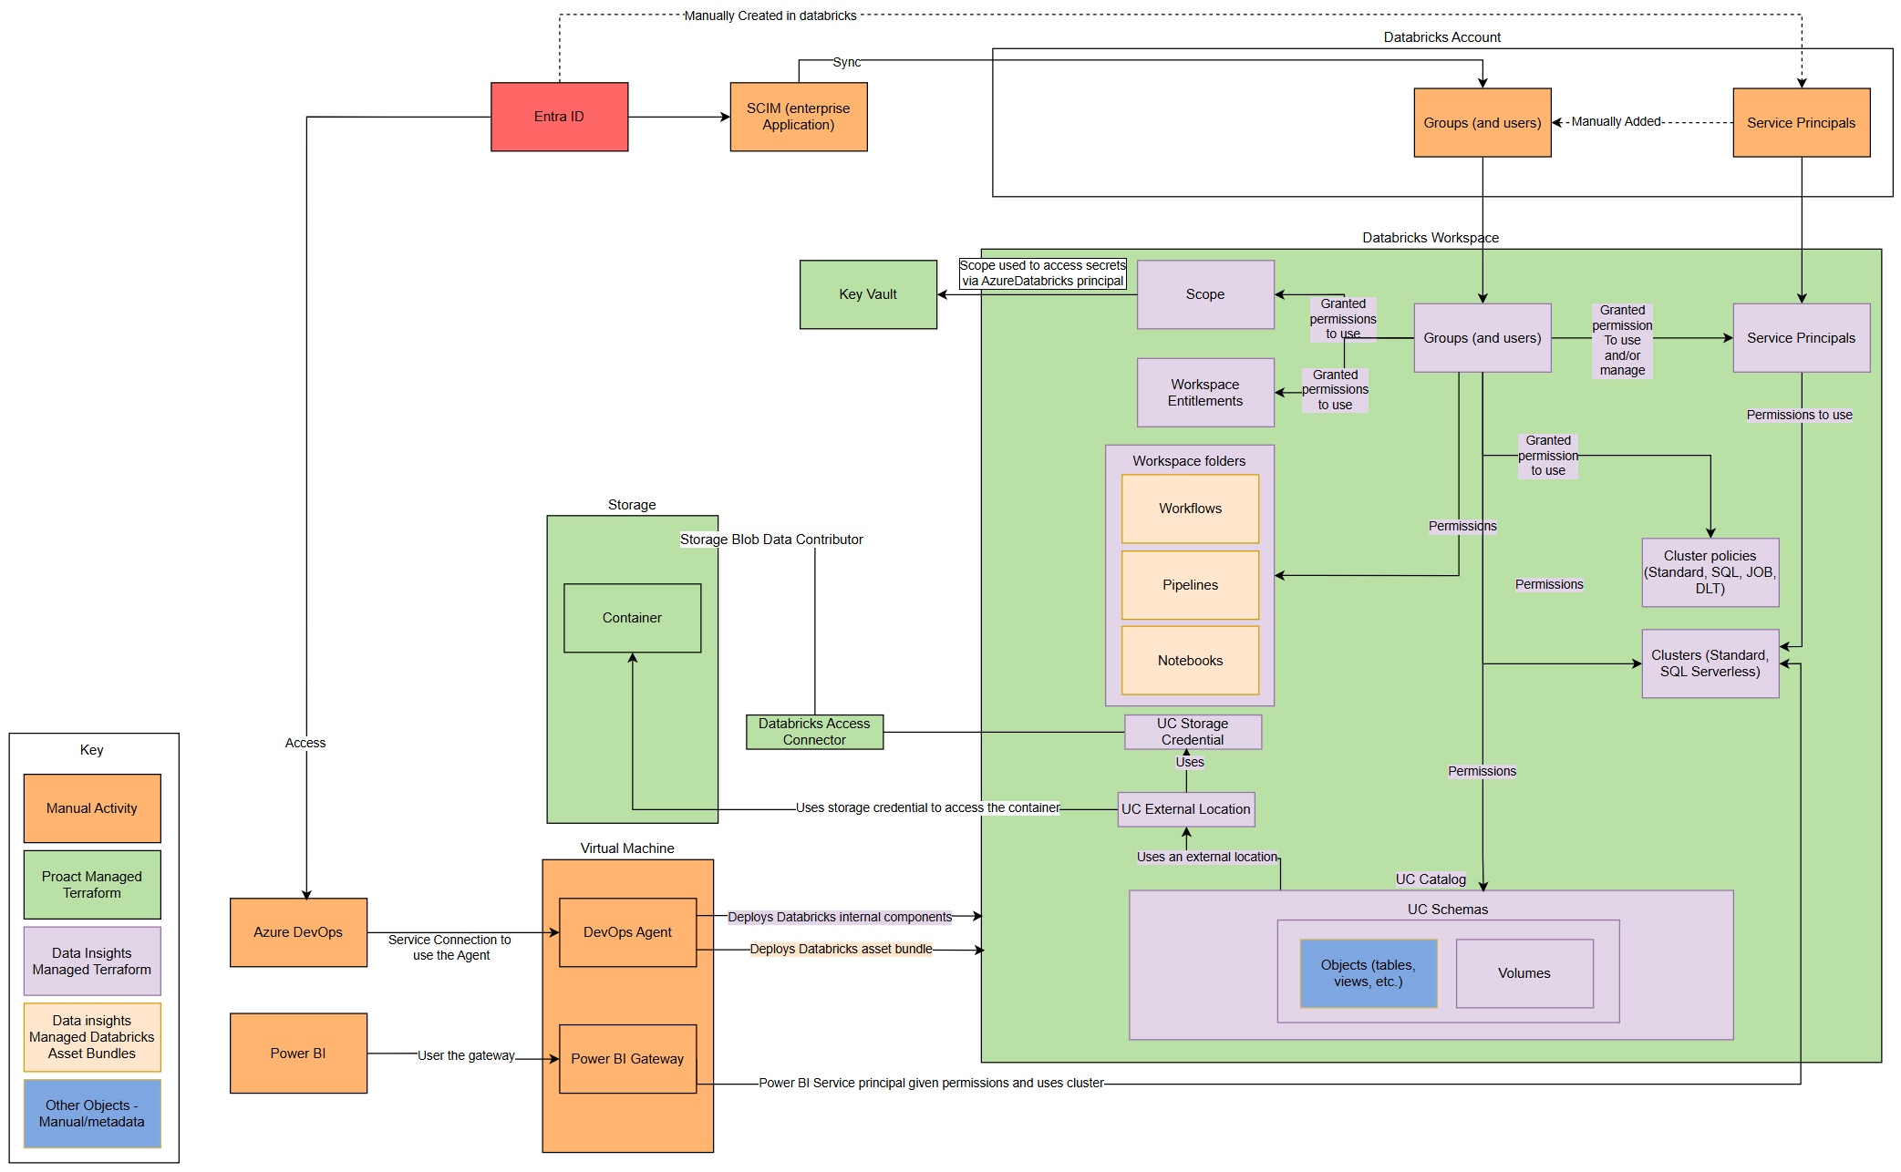
Overview Databricks deployment approach
Diagram illustrating what is proposed to be deployed across various mechanisms

Slide 5
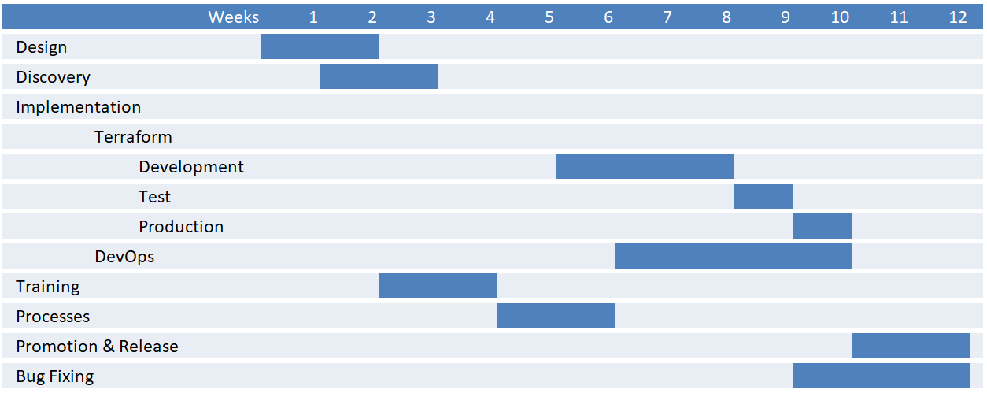
Plan – Data Insights
The following plan covers data insights development, testing and production workspaces only.
Data Science will follow in a phase after completion of main insights workspaces
Scope Item | Data Insights
Design | Decisions on: modular approach Config values and iteration / hardcoded DevOps release pipeline structure
Discovery | Understanding what is in each of the environments: Workspace permissions Cluster Policies Clusters SQL Warehouses Workspace Folders Catalogs Schemas Volumes Bindings
DevOps | Pipeline to validate the terraform on commit Build of the release pipeline for doing the plan and approval for release
Processes | How to raise a request and how to action

Slide 6
Status – Data Insights – 22nd August 2025
Summary: Completed Discovery, 95% of Design complete and documented on Wiki. Implementation in progress ahead of schedule, approx. 15 % complete
 | What we have done | What is next
Design | Resources and Modules design completed (apart from clusters) Design documentation available on the project Wiki Generic Devops pipelines design completed (needs to be more detailed) | Completed the clusters design Make the Devops pipelines design more visual and aligned with Insights Focus on how the pipelines workflow will work in terms of approvals
Discovery | All the resources on databricks Insights dev identified and documented Static imports of all the resources done | Identify databricks Insights test and prod resources Identify databricks Data Science resources
Implementation | Folder’s and file's structure completed Dynamic imports code structure almost completed Permissions module almost completed for dev | Finish the dynamic imports Finish the development of all the modules for dev Start the implementation for the remaining environments
Issues
None identified
Risks
Clusters resource design taking longer than expected due to the linkage with the cluster policy: It doesn’t seem to exist a way of importing all the respective policy defined arguments without having to define them one by one. We have a working solution in place, but checking with databricks if better alternative

